Slide 1


Slide 2

Introduction About Innovation Club
https://www.youtube.com/watch?v=A1VXU4Zk_u4&t=30s

Slide 3
Innovation Club
The Innovation Club has been set up in Government, Non-Government, Grantee In Aid Colleges and Gram Vidhyapith, all over the State of Gujarat with the noble intention that even non-technical students, (studying in Arts, Commerce and Science Colleges) under which plentiful number of students will be encouraged for creative ideas and will be prepared for startups.
Innovation club is a concept to inspire and indulge non technical students to work on their ideas and convert them into startups. Innovation club is based on STEM pedagogy.
With help of innovation club students can generate their ideas and convert this ideas into real life products with tools provided by innovation club.

Slide 4


Globe with AR

Slide 5

What is AR?
AR stands for Augmented Reality
AR technology is a technology that combines virtual information with the real world.
The technical means it uses include Multimedia, 3D-Modelling, Real-time Tracking and Registration, Intelligent Interaction, Sensing and more.

Slide 6

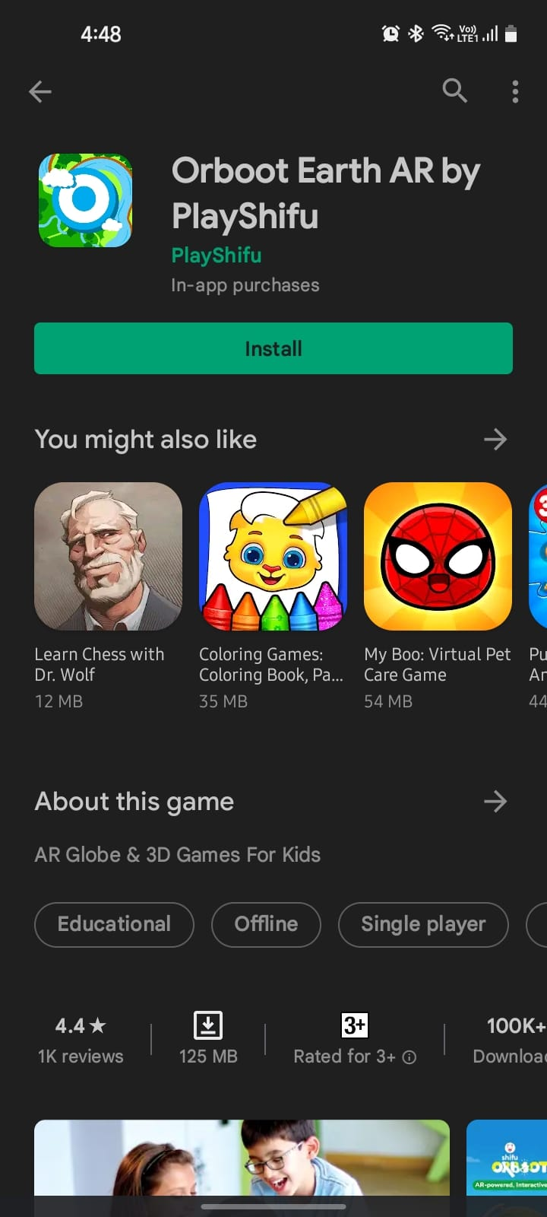
Download the App
Download the Orboot Earth AR by PlayShifu application from the Play Store
https://play.google.com/store/apps/details?id=com.playshifu.appnew&hl=en&gl=US

Slide 7


About Orboot Earth App

Slide 8
Mechatronics Kit
Use the blix kit manual

Slide 9
Advance Science Kit

Slide 10
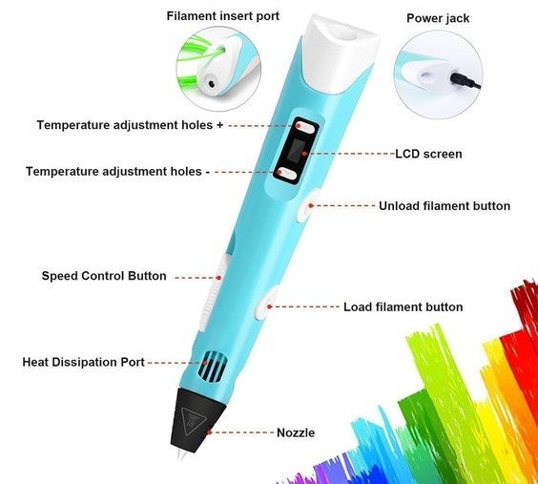
3D pen

Slide 11
Material used in 3D pen
PLA – Poly Lactic Acid
ABS – Acrylonitrile butadiene styrene
Temperature: 190 C to 220 C
Temperature: 240 C to 270 C

Slide 12

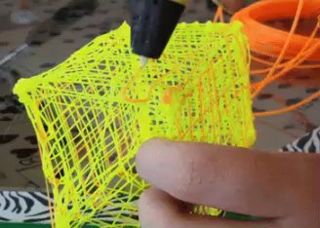

What you make with 3D pen?

Slide 13
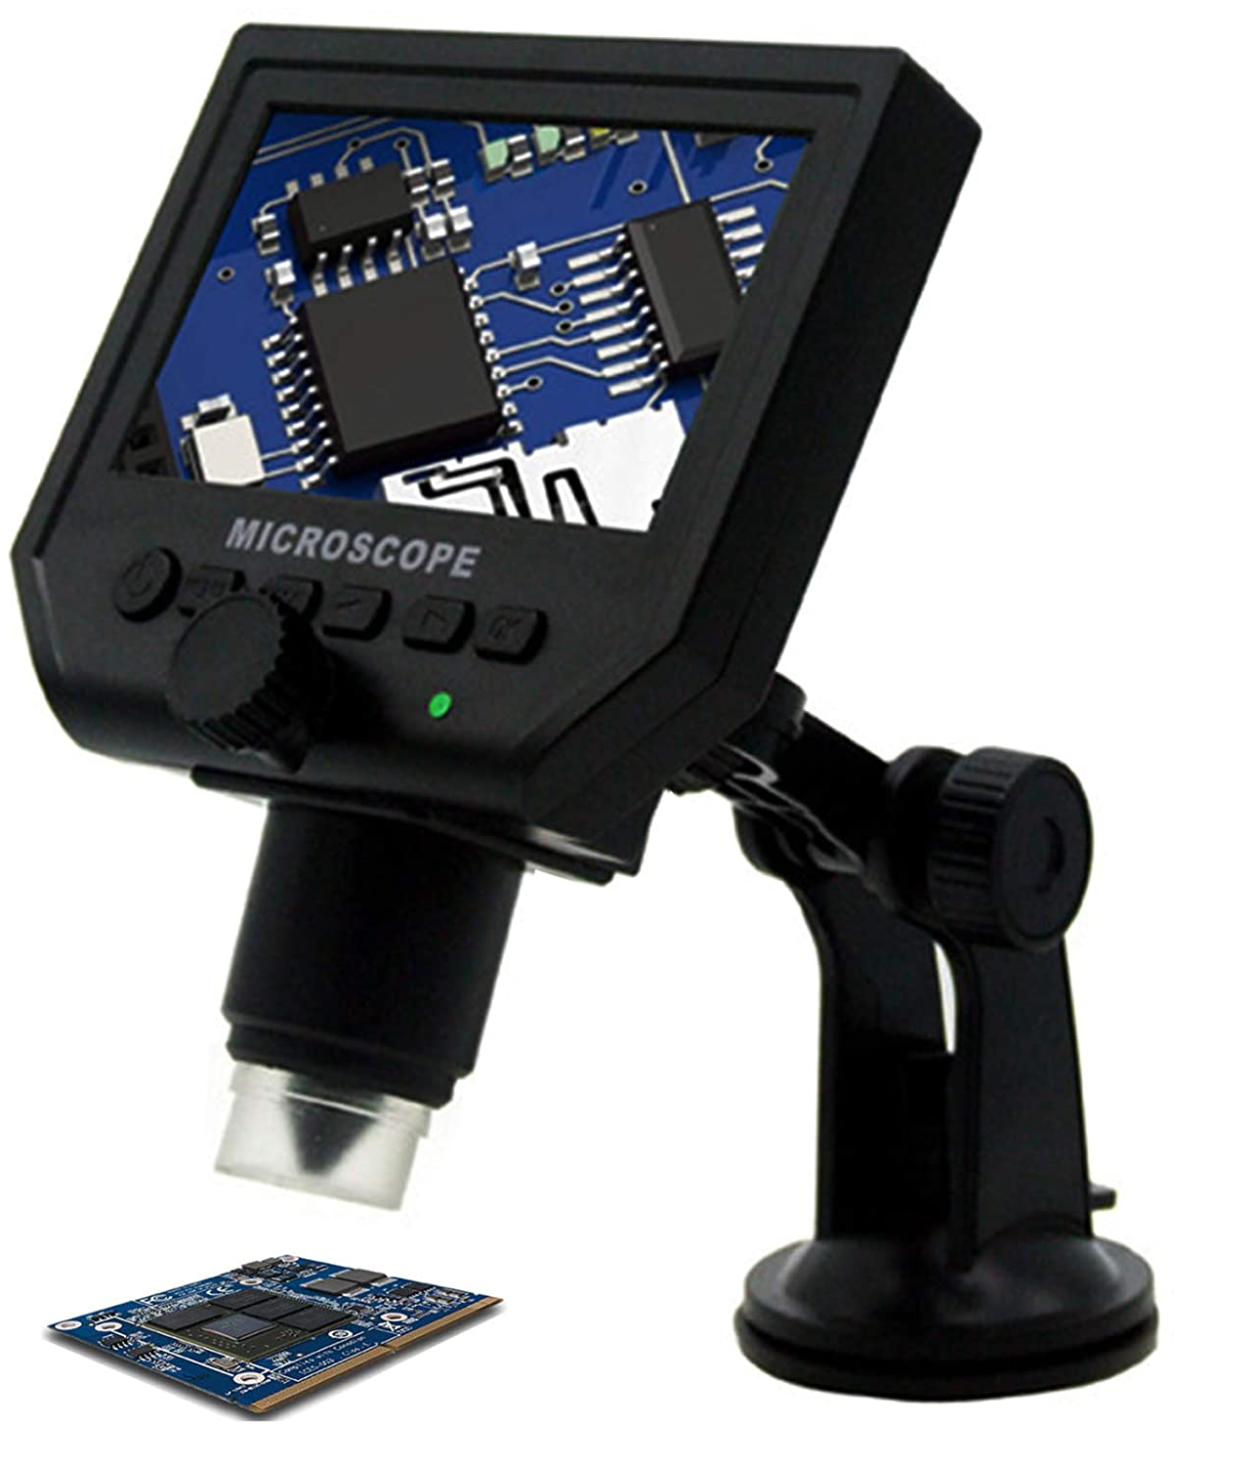
Digital Microscope

Slide 14
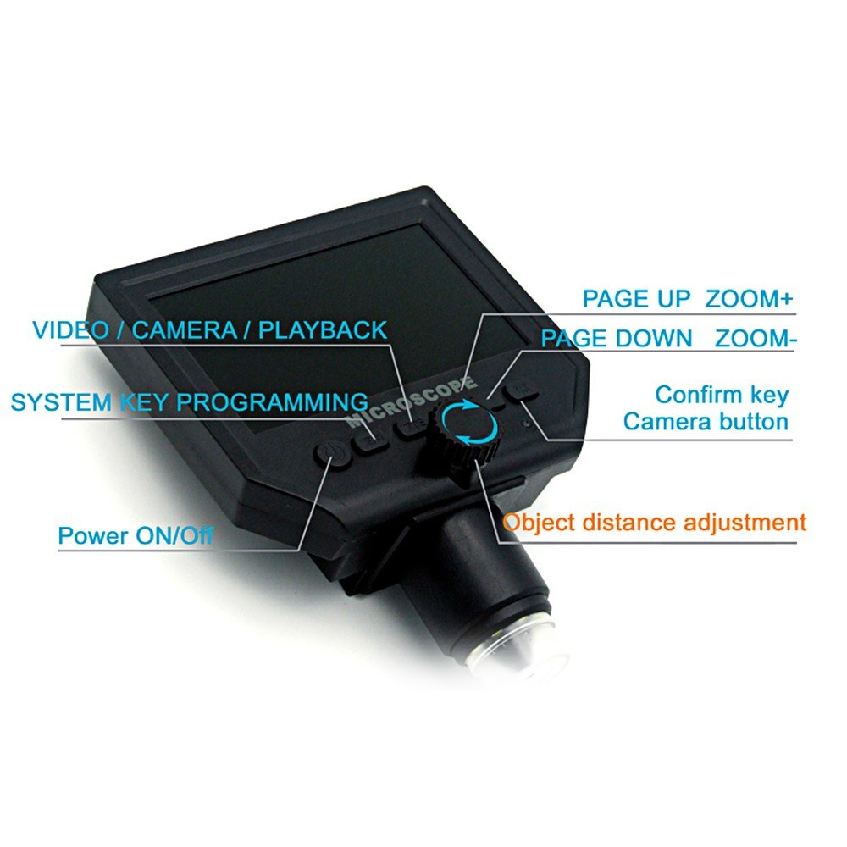
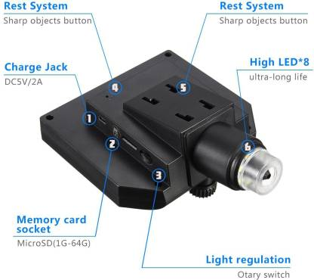
Parts of digital microscope

Slide 15
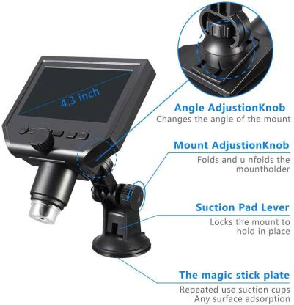
Parts of digital microscope

Slide 16
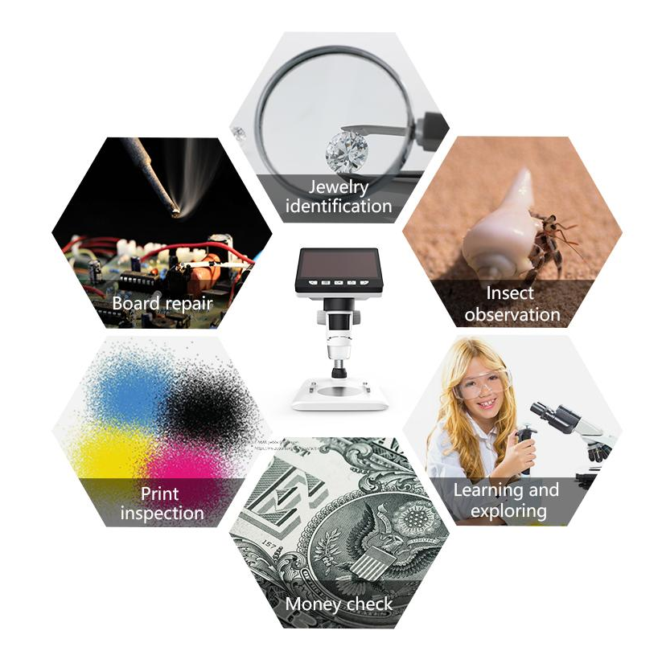
Use of Digital Microscope
Jewelry identification
Board repair
Print inspection
Money check
Learning and exploring
Insect observation

Slide 17


PH meter

Slide 18
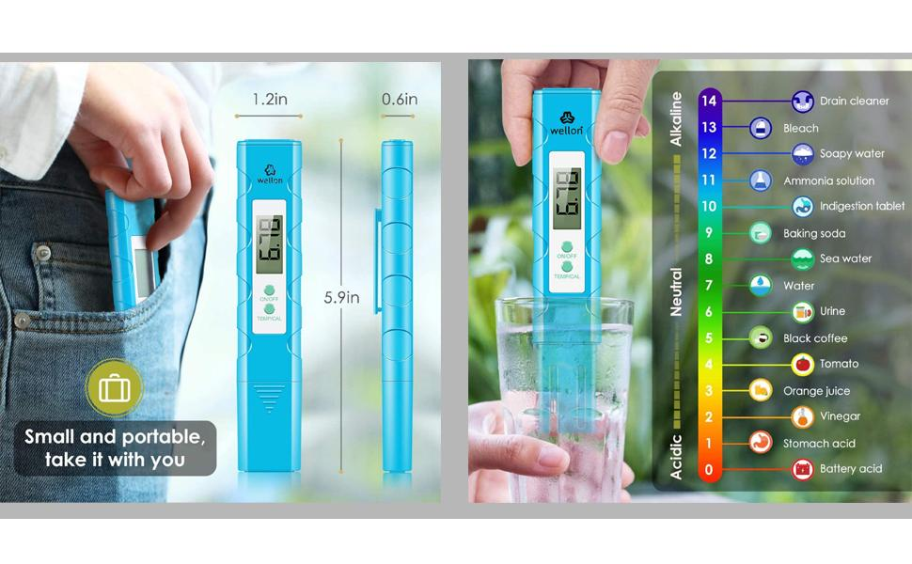
PH meter readings and acidic level

Slide 19

Use of PH meter

Slide 20
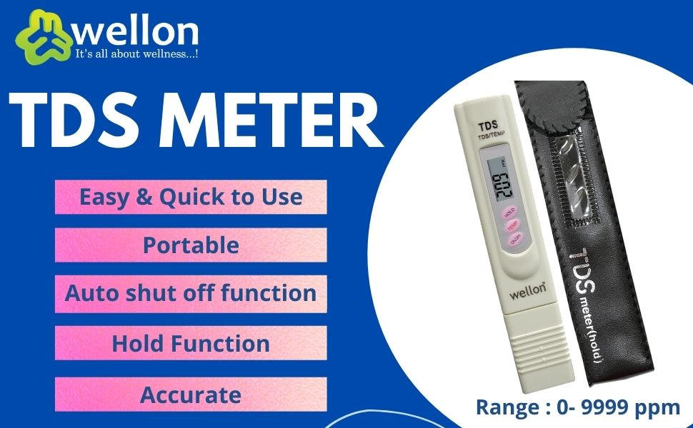
TDS ( Total Dissolved Solids) meter

Slide 21


Slide 22

Usages of TDS Meter

Slide 23
FoldScope
Use the instruction manual available in kit

Slide 24
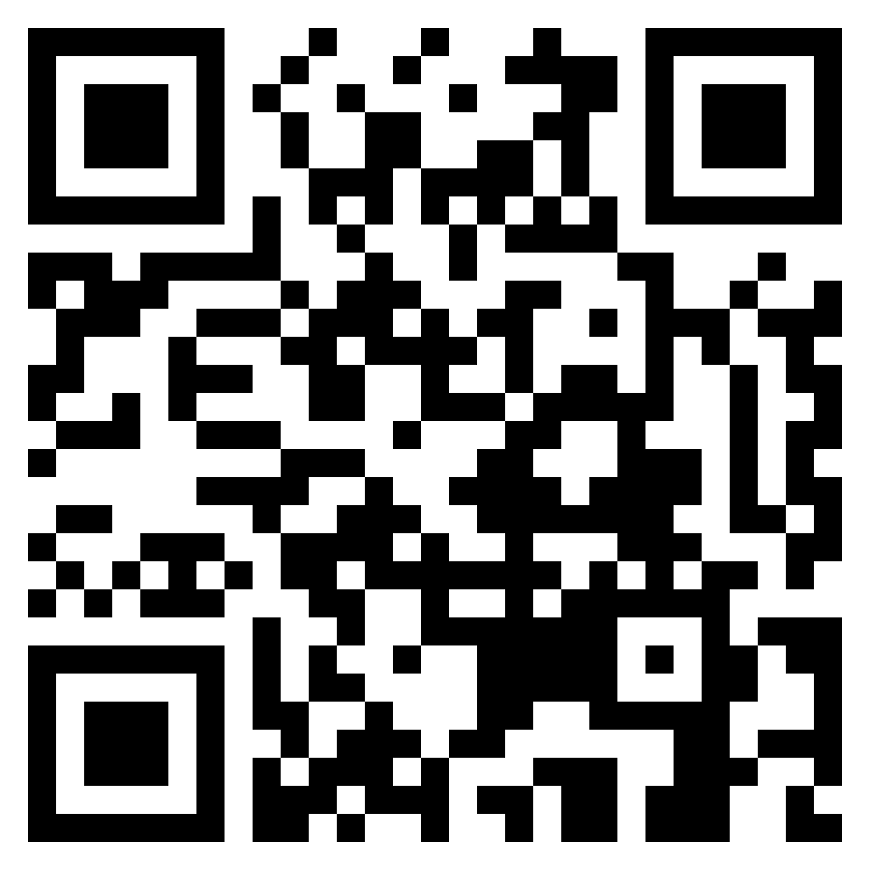
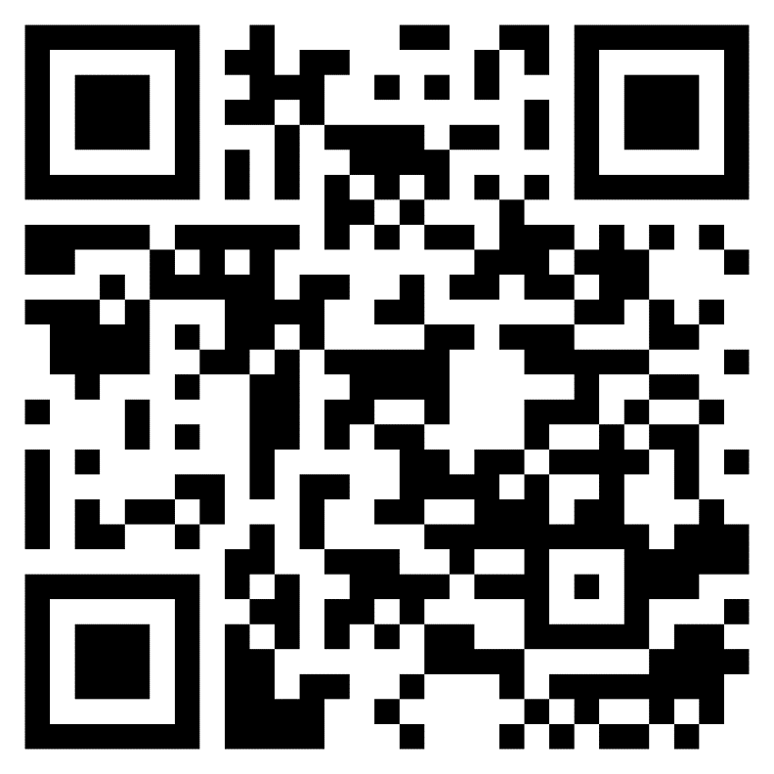

QR Codes
Quiz form
Feedback form

Slide 25



Social Media QR Code

Slide 26
THANK YOU

